Slide 1
Design Patterns
Chapter 1

Slide 2
OO Design 101
How does one use Object-oriented technology to design a software system?
What were you taught in CS 1410 (CS1)?

Slide 3
OO Design 101
Look for nouns
  Good candidates for classes/objects
Then, what are these objects responsible for?
  Good candidates for methods
Then, look for relationships among types of objects
  Is-a, Has-a, Uses, etc.

Slide 4
The Role of Inheritance
Key use is for Is-a relationships
  Refining types into subtypes
Has the side benefit of code sharing
  AND Concept sharing
  But this can be abused
Inheritance is overused or misused by novices
  Been there, done that, got the T-shirt, wore it out

Slide 5
Inheritance’s Secret
The chief benefit of inheritance is in design
  And design is conceptual
  It helps us think about the problem and solution
Code sharing (e.g., virtual methods) is just a bonus

Slide 6
The SimUDuck App
(Chapter 1 in the book)
Duck Pond Simulation
Ducks quack and swim
There are different kinds of ducks
Let’s draw the design:

Slide 7
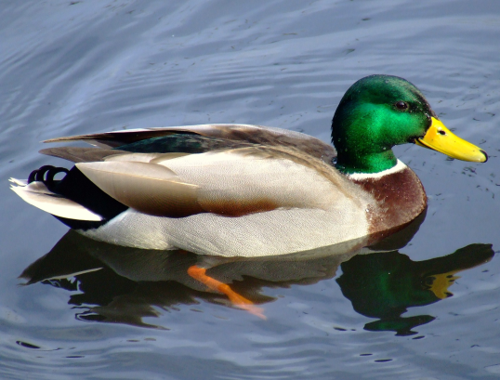
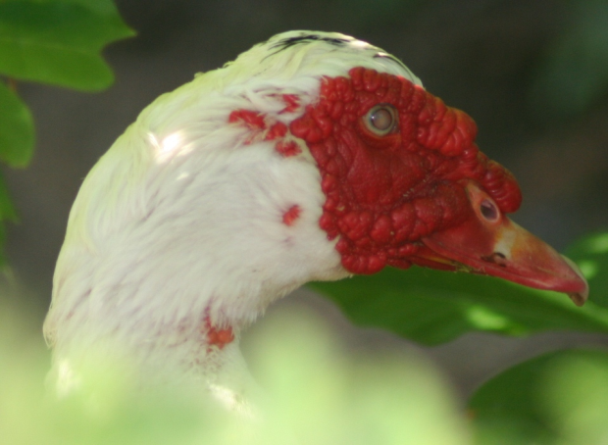
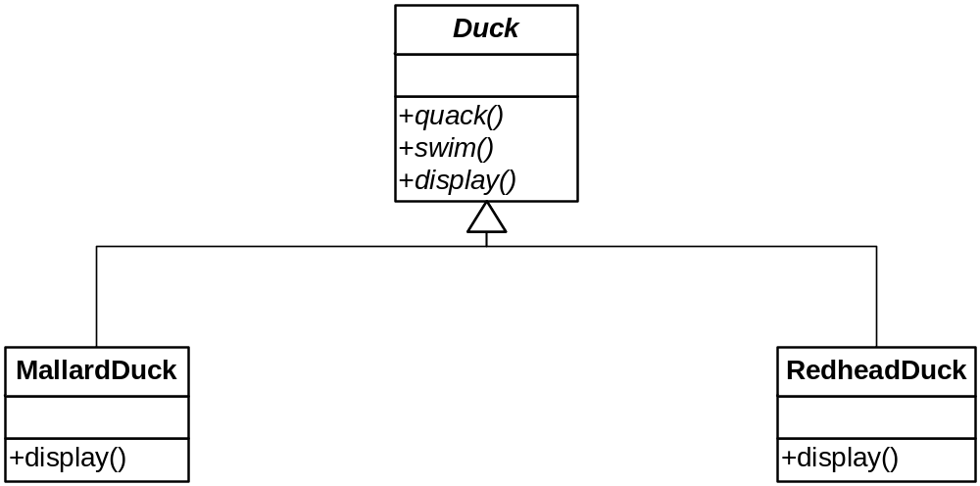
Initial Class Diagram

Slide 8
A Good Start
We figured out that Duck is abstract and it holds what is shared by all Duck types
We override what is polymorphic
As we continue our analysis, we note that ducks must also fly
  It doesn’t matter that we didn’t think of that from the outset
  We must continually adapt our design

Slide 9
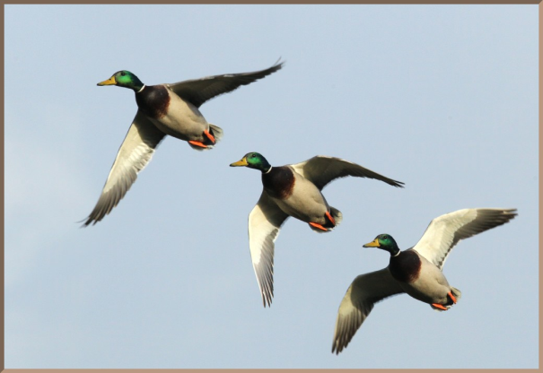
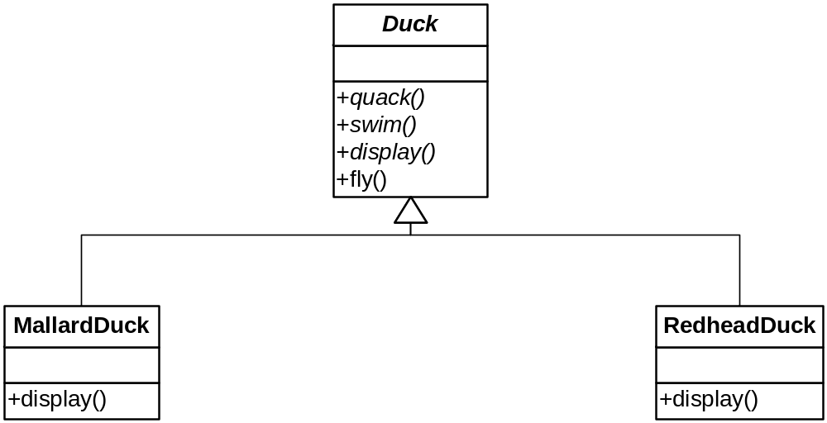

Slide 10
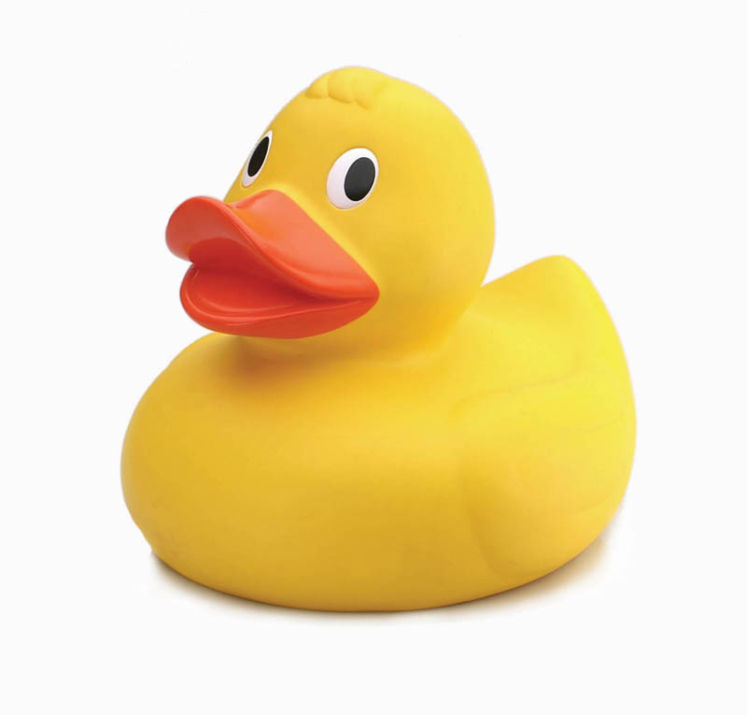
Continuing On…
We now need to support Rubber Ducks
They squeak instead of quack
  No problem, we’ll override quack( )
So we add this class…

Slide 11
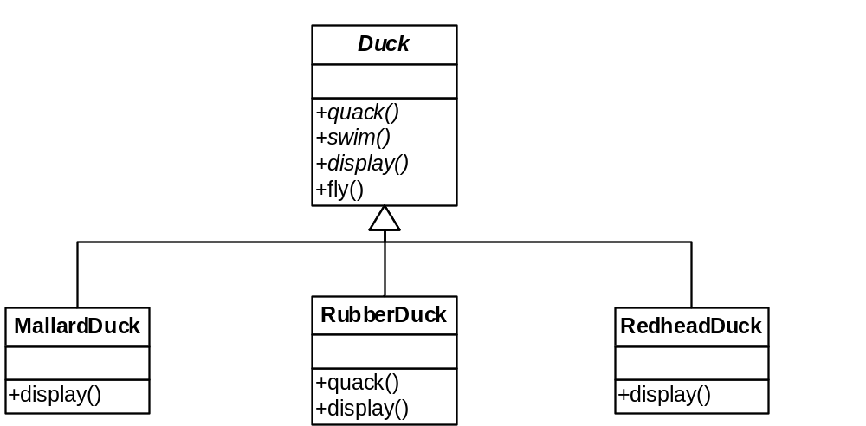

Slide 12
Evaluating the Design
Advantages:
  Easy to do!
  Didn’t have to change the base class!
Disadvantages?
  Reading the code: opportunity for confusion
  (It violates a principle we will learn later)

Slide 13
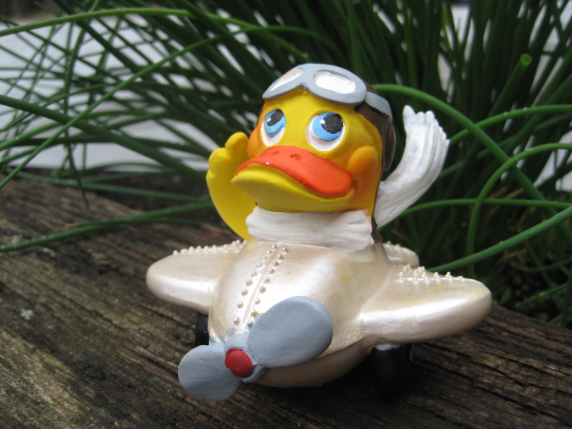
How Are We Doing?
Rubber Ducks don’t fly!
How are we going to correctly fit Rubber Ducks into the hierarchy?
We could override RubberDuck.fly( ) to do nothing

Slide 14
Remember: “Embrace Change”
Adding no-op methods ad nauseum for new classes doesn’t feel quite right, or does it?
What happens when we add DecoyDuck
  Which neither flies nor quacks
We get operation “holes” in our hierarchy
  Which is a form of code duplication (violates DRY)

Slide 15
Inheritance is not The Answer
Not everything we’ve put in the Duck class should be inherited
  Some ducks don’t fly, etc.
Inheritance is specified statically (before runtime)
  It is too rigid to easily accommodate change like this
  We must change code

Slide 16
Insight
Principle!!!
Encapsulate what varies and separate it from the rest of your code
  Reduces coupling among classes
  Reduces chances of duplicating code later on
What does this mean, exactly?

Slide 17
Proverb
“All problems [in computer science] can be solved by adding another level of indirection”
In other words, create a new class to encapsulate what is needed
  Then glue it in appropriately

Slide 18
Design Principle
“Identify the aspects of your application that vary and separate them from what stays the same.”
You decide what varies and what doesn’t
  Not cast in stone (humans still required!)
This principle underlies most patterns

Slide 19
Commonality/Variability Analysis
You already understand this in part
  Polymorphism via virtual functions separates what changes (the implementation) from what stays the same (the interface)
But there are other ways to provide the needed separation
  Subtype polymorphism is only one narrow manifestation of this principle
  Finding just the right composition is as much art as science
    In other words, humans are still required

Slide 20
Separating What Varies
Let’s see what happens if we encapsulate Flying and Quacking behaviors in their own classes
In other words, the implementations of these behaviors go into their own respective hierarchies
  There still needs to be something in Duck that ultimately invokes these behaviors, of course
  That is, the interface is still there

Slide 21
Design Principle
“Program to an interface, not an implementation”
So, we need to further separate the two…

Slide 22
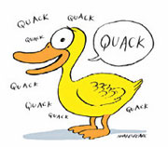
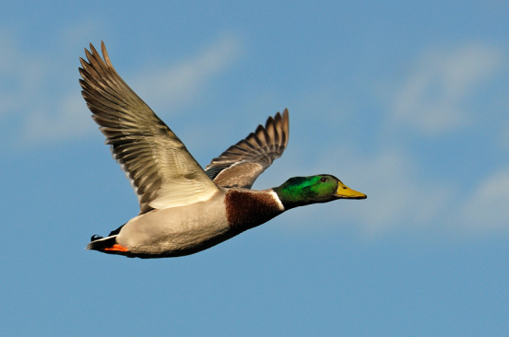
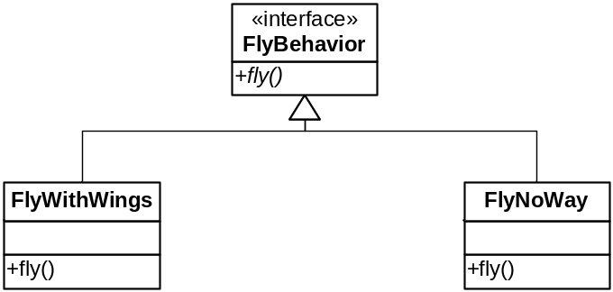
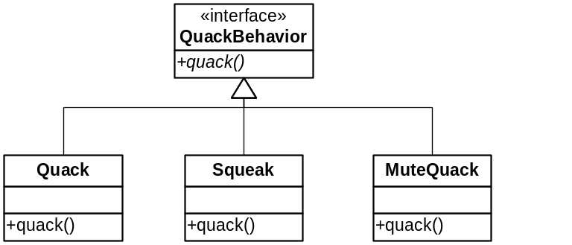
The Varying Behaviors

Slide 23
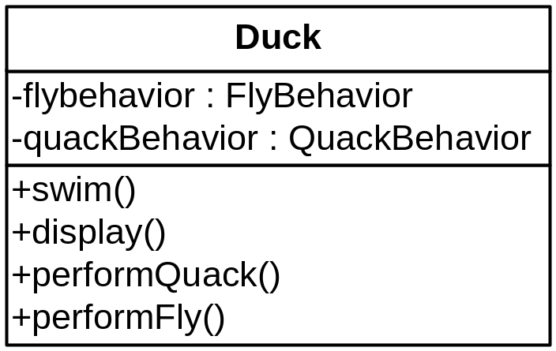
Glue the Behaviors in Appropriately
The Duck class will hold supertype references to concrete behavior objects

Slide 24
How Are The Behaviors Initialized?
For now, we’ll just give each concrete type the appropriate object when we create it
  In constructors
Later in the course we’ll see the Factory Method Pattern
  Makes creation more flexible

Slide 25
How Does a Duck Behave?
Very well, thank you!
Seriously, we call performFly( )
  Which calls this.flyBehavior.fly( )
  Likewise for performQuack( )
The name is immaterial
  We could have left them as fly( ), quack( )
    I would have

Slide 26
Benefits of This Design
We can add new behaviors without affecting the Duck class
  Simple polymorphism does this too, but this design puts the behaviors in a single place (DRY!)
Also, these classes are independent of Duck and can be used in other contexts

Slide 27
Another Benefit of This Design
We can change a Duck’s behavior at runtime
  Add a setFlyBehavior( ) method
Not that we would want to
  Duck’s aren’t that dynamic!
But other contexts would want such flexibility

Slide 28
What We’ve Accomplished
We have separated families of behaviors (algorithms) from the clients that use them
  Clients only have a polymorphic reference thereto
    With Factory Method, they won’t even know which implementation they have!
The algorithms are dynamically interchangeable
The algorithms are stand-alone
  Can be reused
We couldn’t do this with inheritance

Slide 29
Design Principle
“Favor Composition over Inheritance”
Of course, we used inheritance
  But not for everything
  Only when we needed an “is-a” or “implements” relationship
Composition is more flexible
  Resist the urge to over-classify via hierarchies

Slide 30
The Strategy Pattern
“Define a family of algorithms, encapsulate each one, and make them interchangeable. Strategy lets each algorithm vary independently from clients that use it.”
Also Known As: Policy

Slide 31
Strategy, Implemented
Class Hierarchy
One virtual method
  (Usually) Only One: The rule of cohesion
Generally no class data
Nothing else…

Slide 32
“Disadvantages”
Lots of extra classes are created
  Who cares?
Some clients must be aware of the different strategies
  Sounds like a feature to me!
Increased overhead due to indirection between client and strategy
  Can’t make inline
  But it’s not much!
Bottom line: disadvantages are very minor
Use it when you need it

Slide 33
Example: Searching
Search criteria:
  The search algorithm is the same
  We can vary the criterion with a Strategy
    At runtime!
    E.g.: name, birthdate, phone number
Hmm… could we use a Strategy to also vary the search algorithm?

Slide 34
Inheritance Revisited
Sudden thought:
  Can we now eliminate the inheritance hierarchy for ducks?
We could create ducks (at runtime) with different policies, e.g.:
  Duck* rducky = new Duck (“Rubber Duck”, new NoFly(), new Squeak());
  But we would have to do something different with display()
Do we want to? Maybe, maybe not
  See next slide

Slide 35
Binding time and Design
If we assign policies at runtime (object creation time):
  Our Duck class hierarchy may be superfluous
But in real life it’s meaningful:
  Mallard Ducks always quack, fly
  Rubber Ducks always squeak and never fly
So it makes more sense to keep the Duck hierarchy
  It’s a design thing, and design is often for humans
Note the binding time!
  When?
  It needs to correspond to real life

Slide 36
Strategy: Changing Behavior
Ducklings can’t fly, but they grow up.
  So their behavior changes
The Strategy pattern allows us to change behavior
  … on the fly (pun intended!)

Slide 37

Changing Strategy, take 1
It’s easy to add a method to change the strategy!
See example
Oops, that didn’t work!
  NOTE: in many programs it will work fine
  Moral: adapt the pattern to fit the situation

Slide 38
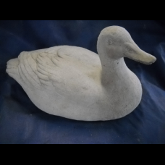
Changing Strategy, take 2
We can check to make sure we don’t change a Rubber Duck’s flying strategy
See Example
It works, but what’s wrong?
We aren’t separating what changes from what stays the same
  How would you add DecoyDuck?
Even worse, driver code must know about concrete duck types
  Violates another principle we will learn later (Dependency Inversion Principle)

Slide 39
take 3 …
Ok, let’s put it in the duck class
And handle the rubber duck case
Works, but …
Look familiar???
  What principles does it violate?
What can we do???

Slide 40
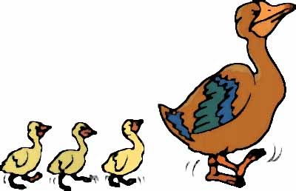
take 4
Hmm … could we consider “growing” a behavior?
And apply the Strategy pattern again?
Gets a bit complicated, but it’s flexible and easily extensible
See example

Slide 41
Writing the Strategy Pattern
The GoF book doesn’t have a Problem and Solution Section
  Let’s see what the GoF book has…
Let’s try to write Problem and Solution for the Strategy Pattern
  This will help you understand how and where to use it…

Slide 42
Strategy
Solution: (we write it first, remember?)

Slide 43
Strategy
Problem, Forces:

Slide 44
Strategy (From Pattern-Oriented Software Architecture, vol. 4)
(Problem) “Some objects need to implement behavior across one or more methods that differ on a case-by-case basis. To identify the case with a flag, so that distinct behavior can be implemented by explicit selection, is however a brittle and closed solution that scales poorly.”
“Therefore, Capture the varying behavioral aspects of the object separately from its defining service class in a set of strategy classes. Plug in an appropriate strategy instance, and delegate the execution of the variant behavior to the appropriate strategy within the implementation of the service class.”

Slide 45
Variations
If you don’t need runtime selection of strategies, you can use templates in C++
  Saves a lot of overhead, allows better optimization
“Policy-based Design”
Examples:
  C++’s container adaptors
  Alexandrescu’s Singleton (in his book)

Slide 46
C++’s Container Adaptors
queue, stack, priority_queue
Implemented with an underlying sequence data structure
  vector, deque, or list
You glue them together at compile time:
  queue<int, list<int> >
  Default is deque<T>

Slide 47
Allocators
The definition of std::vector:
template<class T,
class Allocator = allocator<T> >
class vector;
std::allocator<T> is a memory management policy
  It uses new and delete
  But you can provide your own custom allocator class
    A pool allocator, say

Slide 48
The Progress of Patterns
OO Basics were a start
  Encapsulation, inheritance, polymorphism
OO Design Principles guide us:
  Program to an interface…
Patterns give us a catalog of already solved problems that occur over and over again
  But with the flexibility to implement as we need:
    e.g., templates vs. hierarchies
    Sometimes we can use only part of a pattern

Slide 49
Benefits of Patterns
Now that you know Strategy, you can:
  More easily identify situations where you need interchangeable implementation families
  Talk and think at a higher level
    Just say “Strategy” instead of…
  Design chunks that are at a higher level than objects or functions

Slide 50
Benefits of Patterns continued
“Patterns short-circuit the discovery interval for many important design structures.”
  “Our studies at AT&T suggest that as much as half of software development effort can be attributed to discovery.”
“More importantly, patterns avoid rework that comes from inexpert design decisions. Programmers who don’t understand [patterns] … spend a long time converging on a solution, or will employ solutions that are less maintainable or just plain wrong.”

Slide 51
Pattern Truths
“Patterns guide humans, not machines”
  Hence not connected to code generation or other automated tools
  Cannot replace programmers!
Patterns will not turn programmers into experts
  Unless they use them over time and absorb the underlying principles

Slide 52
Summary of Principles So Far
Don’t Repeat Yourself
Separate what varies from what stays the same
Program to an Interface, not an Implementation
Favor Composition over Inheritance

